Slide 1
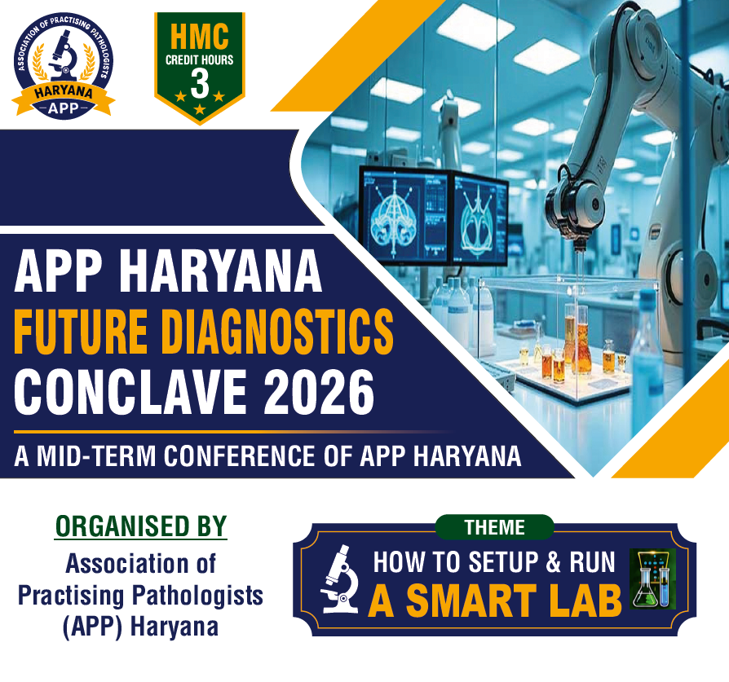

Slide 2
What is Digital Pathology?
Conversion of glass slides into digital images for analysis, storage, sharing, and interpretation.

Slide 3
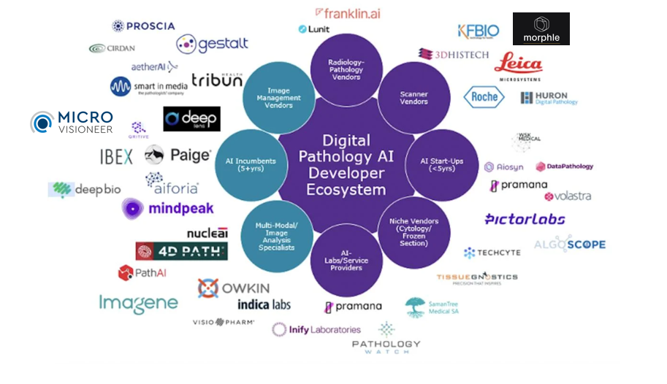
Global Digital Pathology Ecosystem

Slide 4
CHAPTER- 1
Conventional Microscope-Based Pathology

Slide 5
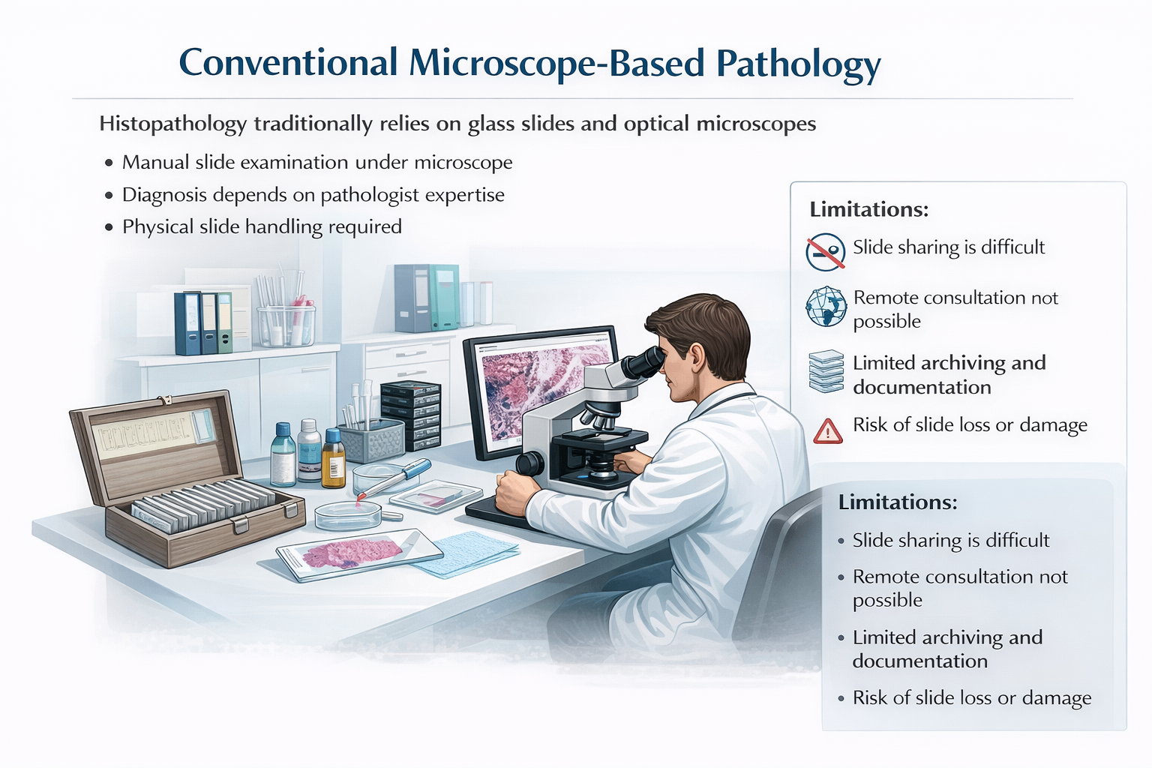

Slide 6
CHAPTER - 2
CAMERA + Microscope - Based JUGAAD Pathology

Slide 7
CHAPTER- 3
KNOW YOUR CAMERA

Slide 8
Why Global Shutter is Better for WSI
• Eliminates motion artifacts during slide scanning
• Provides higher image fidelity for histopathology
• Improves tile stitching accuracy
• Enables faster scanning speeds
• Produces reliable images for AI analysis
• Preferred technology for precision digital pathology scanners

Slide 9
CHAPTER - 4
MANUAL WSI SCANNER SYSTEM

Slide 10

Re-imagine Affordability…
DIGITAL PATHOLOGY SOLUTIONS ARE FOR
THE MANY…

Slide 11
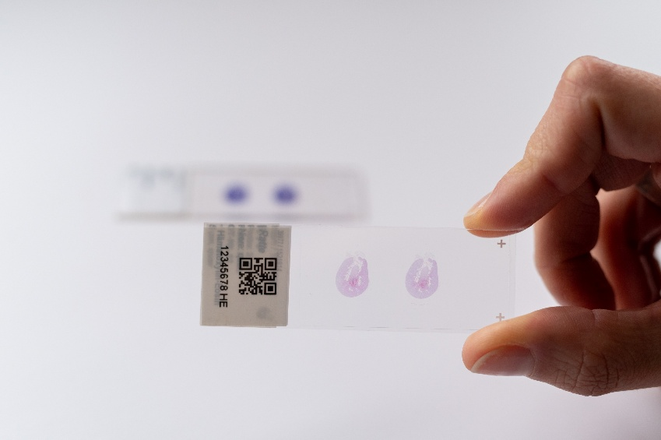
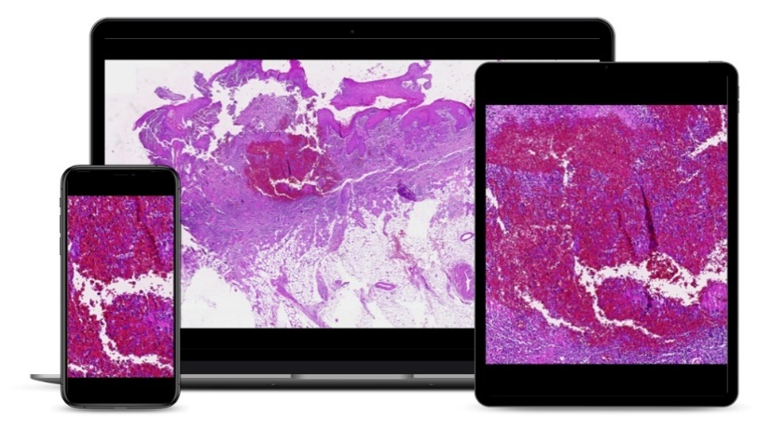

Manual Scanning Software
Alternative or add-on to automated slide scanners
Enables upgrading of microscopes to manual slide scanners
Software and hardware components (camera, camera adapter) readily available

Slide 12
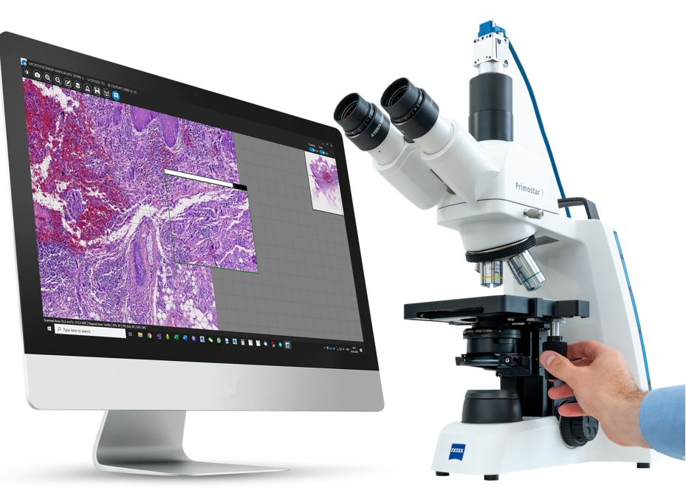
The Manual Scanning Process
Upgrade your microscope to a manual scanner with a suitable camera and the scanning software
Create zoomable Whole Slide Images by manually moving the stage
View, analyze, archive or share virtual slides

Slide 13
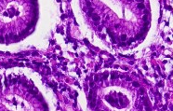
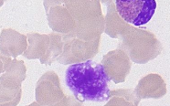
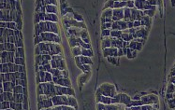
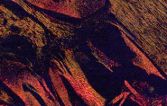
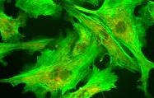
Applications
brightfield
oil immersion
phase contrast
polarized light
fluorescence
histochemistry - immunohistochemistry - immunofluorescence - cytology - hematology - material science

Slide 14
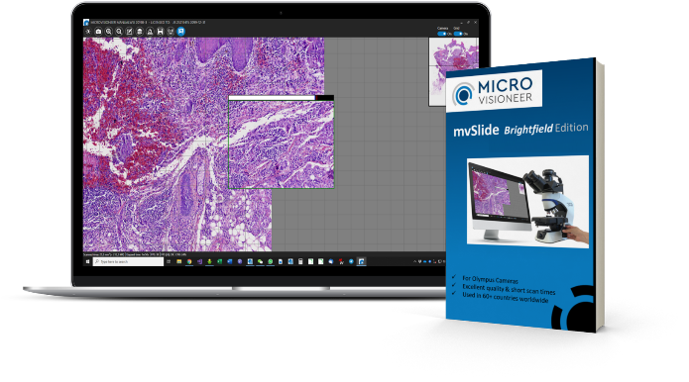
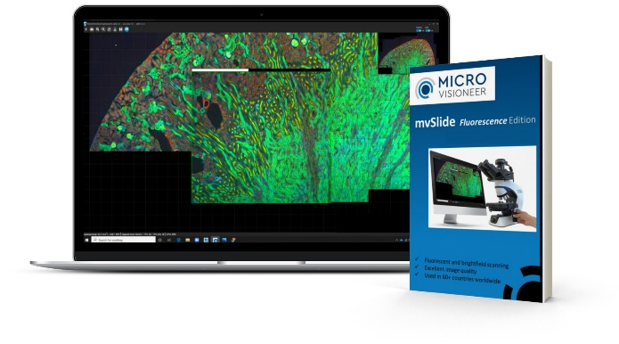
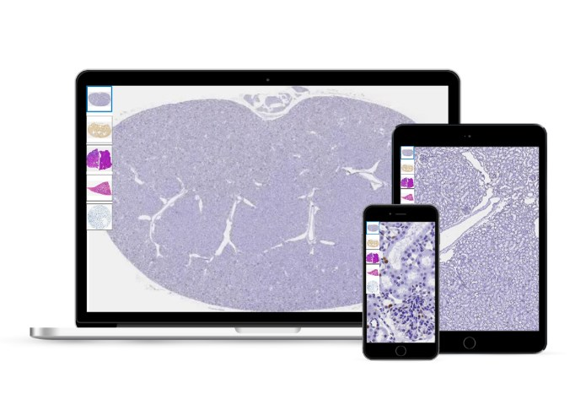
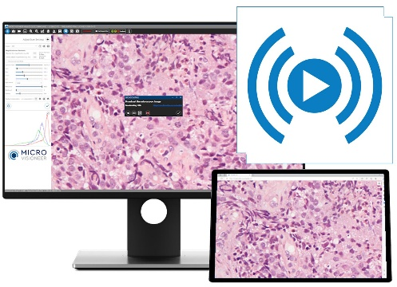
Manual Slide Scanning Advantages
Brightfield & Fluorescence
manual scanning solution to create digital whole slide images Brightfield and Fluorescence Edition
telepathology solutions
Link based
softwares
mvLive
software
live broadcasting

Slide 15
Advantages Cont.....
Time-saving:
Software is immediately available.
Scanning of small specimens is often faster than
automated scanning.
Compensation of potential outage of automated scanners.
Scan right away on your desk.
manual creation of Whole Slide Images
Affordable:
Upgrading of microscope only with inexpensive hardware and the mvSlide software.
Long-lasting solution without expensive maintenance.
Maintains traditional
microscope features:
Any desired objective can be selected.
Slides can still be assessed through the
eyepiece.
$
✓
Suitable for exceptional slides:
Exceptionally thick slides or slides with varying focus
plane can be easily scanned due to flexibility of microsope.

Slide 16
Manual Scanned Slides from routine Microscopes
1) BRIGHTFIELD SCANS : https://mvsli.de/cyto : CYTO & PAP SCANS
2) OIL IMMERSION : https://mvsli.de/hematology : MANUALY SCANNED HEMATOLOGY SLIDES
3) FLUORESCENT SCAN : https://mvsli.de/FL : MANUALLY SCANNED FL SLIDES

Slide 17












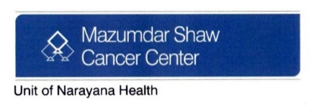








Users Across Globes

Slide 18
Manual Scanners
Development of software solution for high-quality manual slide scanning.
2024
80+
2018
30
2017
15
number of countries using Manual Scanning

Slide 19
Workflows
available 3rd party tools
Analyze
Share
Scan
View
Telemicroscopy:
Second opinion
Tumor boards
Education
...
mvSlide
Share
InstaSlide
DIGITAL IMAGE
ACQUISITION
EVALUATION &
DIAGNOSIS

Slide 20

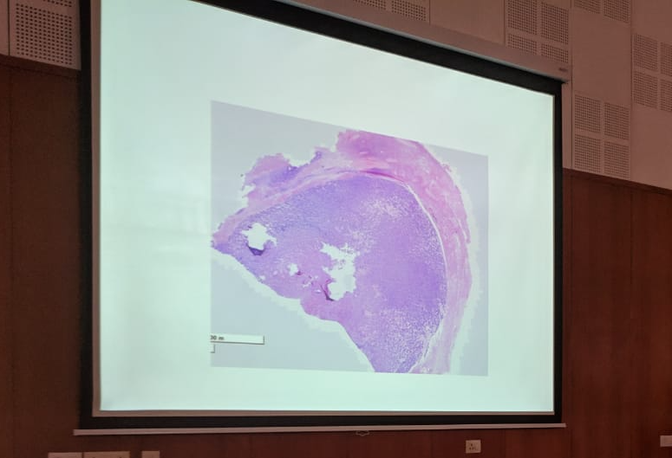
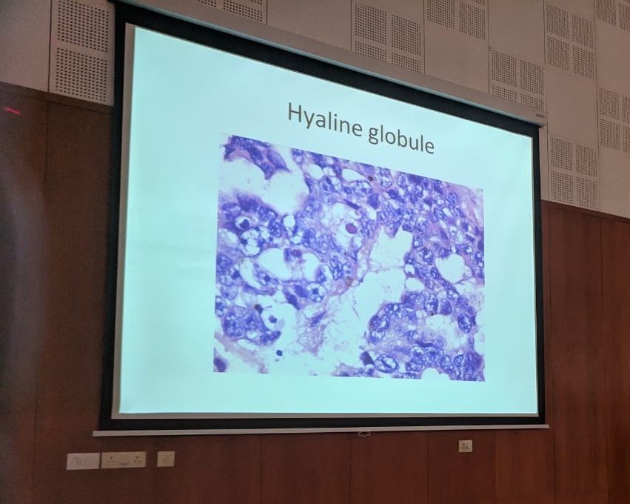

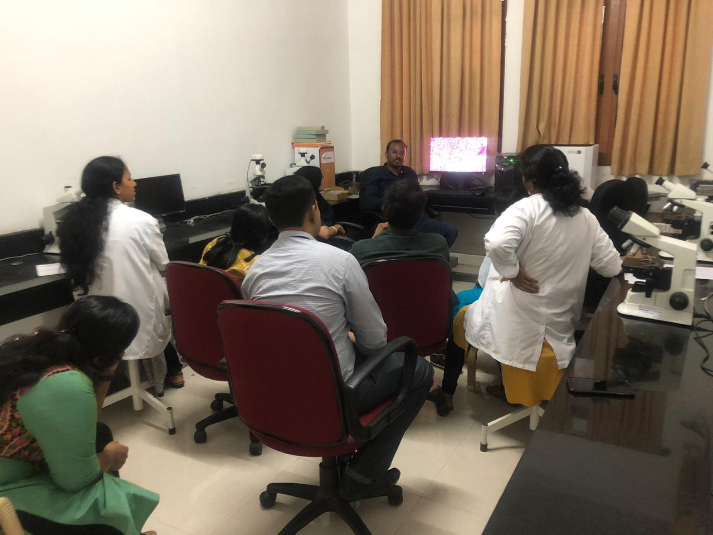



Imagine Education…
Re Imagine Education…
Digitize and annotate teaching slides
Preserve forever…Access Anywhere Anytime…
Digital PG Slide Seminars
Digital UG Practicals
Digital Quizzing and Exams
…learning at its best!!

Slide 21
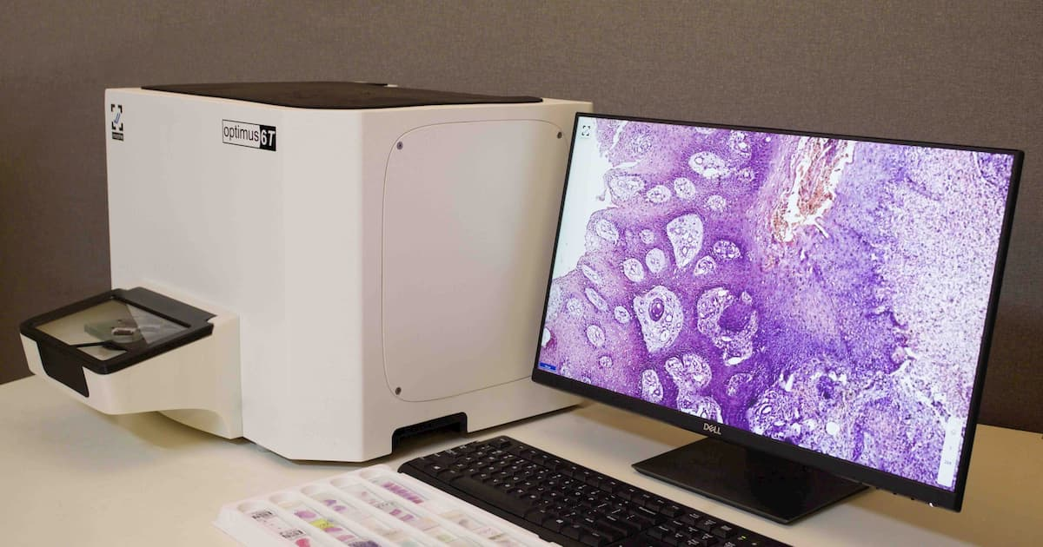

Slide 22



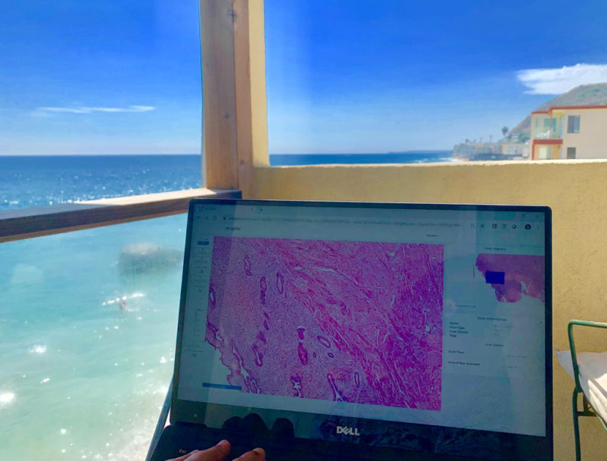


Re Imagine Work-Flow…
Sub speciality Tele-Reporting
work remotely
Centralized Reporting
home / vacation for emergencies
Superior Ergonomics Break free from neck pains
...... Comfort meets Efficiency!

Slide 23
CHAPTER - 6
IMAGE MANAGEMENT SYSTEM

Slide 24
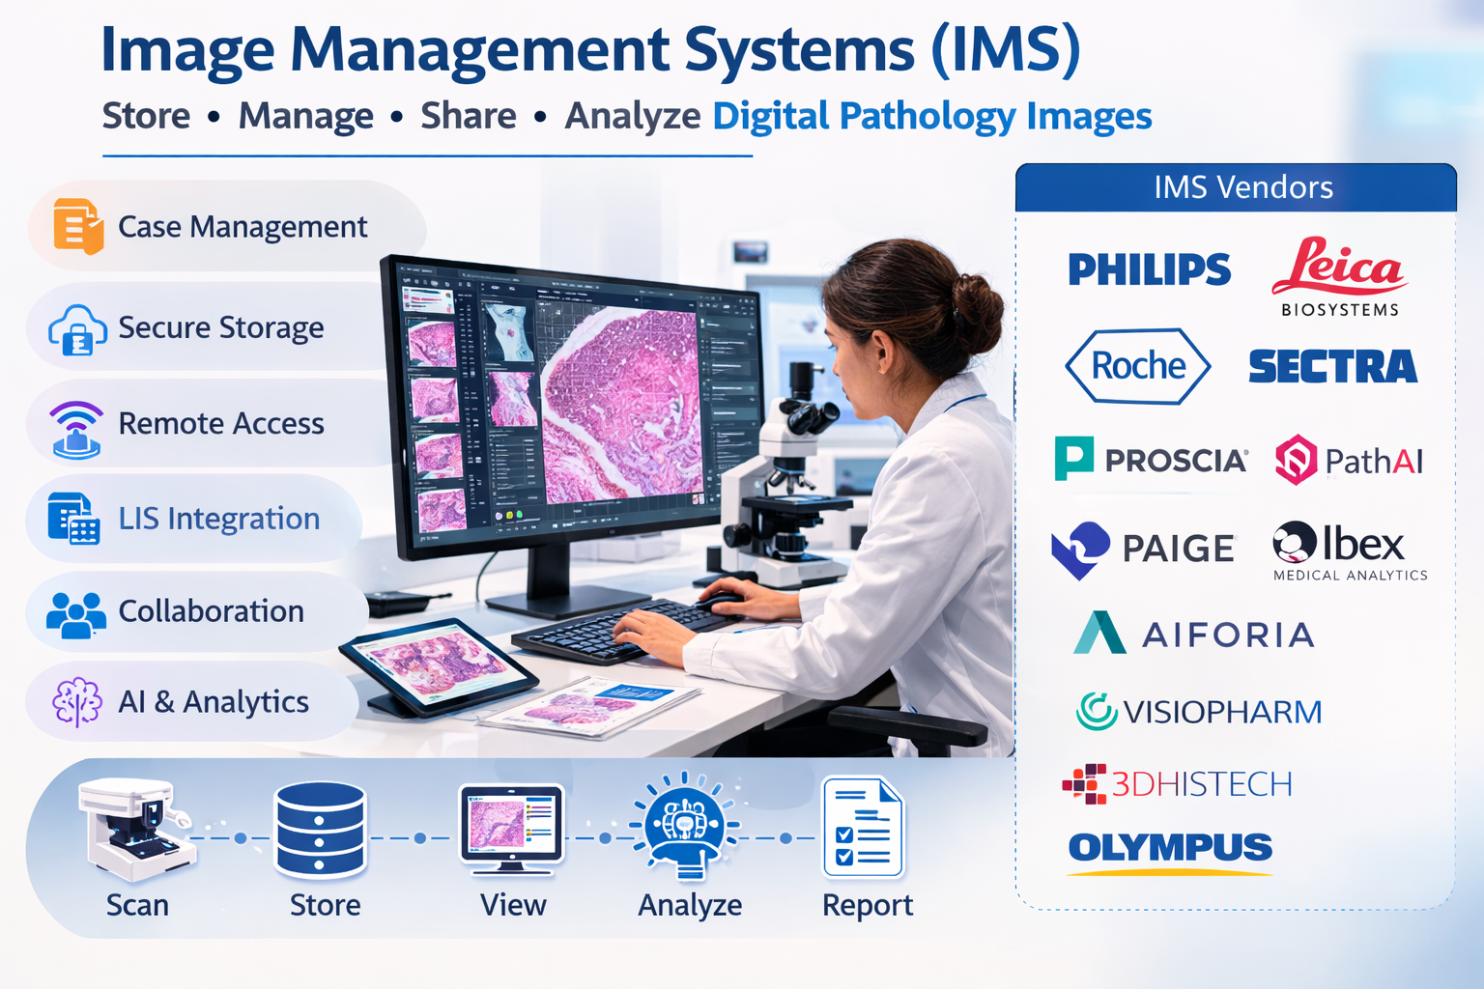

Slide 25
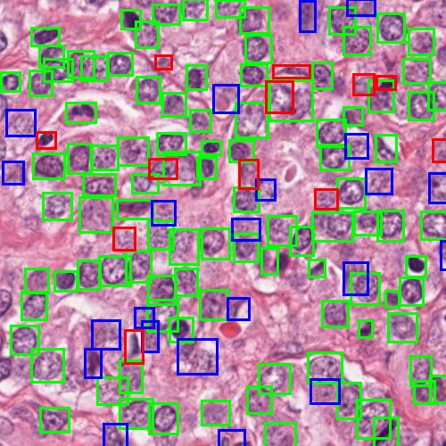
Role of Artificial Intelligence
Automated detection and quantification
Predictive modeling
Biomarker discovery
Decision support for pathologists

Slide 26
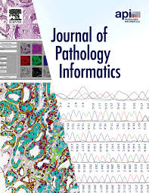
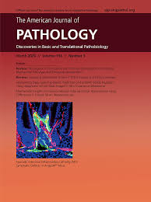
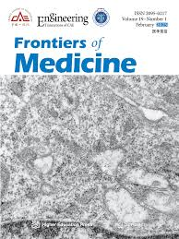
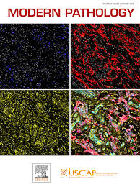
THE JOURNALS TO DP WORLD

Slide 27
Additional Popular Open-Source WSI Viewers (not shown in the image)
QuPath ⭐ (Most popular open-source digital pathology viewer)
OpenSlide
SlideRunner
ASAP (Automated Slide Analysis Platform)

Slide 28


THANK YOU

Slide 29


Slide 30
The Road/Change Ahead
Greater adoption in hospitals
Standardized workflows
AI-assisted diagnostics becoming routine
Integration with genomics and radiology
Advanced AI-driven diagnostics
Cloud-based pathology platforms

Slide 31



MEMBERSHIPS

Slide 32

Go Digital Now!
THANK YOU

Slide 33

WEBSITE : https://www.WESTBYPATH.com

